Slide 1
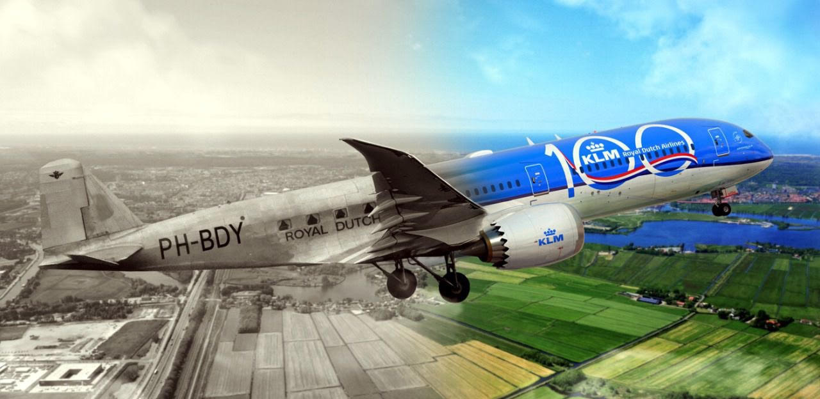
PRELIMINARY SIZING 1
AESP 415 – Aircraft Design Part I Basics
Lecture 7
MODULE
2
TOPIC 6
Dr. Wout De Backer
1000 Catawba St, Ste 120
wdbacker@cec.sc.edu

Slide 2
Are you on track for this course?
Have you generated 3 concepts for your requirements?
Have you worked on your CAD models (generating/annotating technical drawings)?
Have you completed the “inside-out” cross-section fuselage design process?
Have you started writing assignment 1 (due soon)!

Slide 3
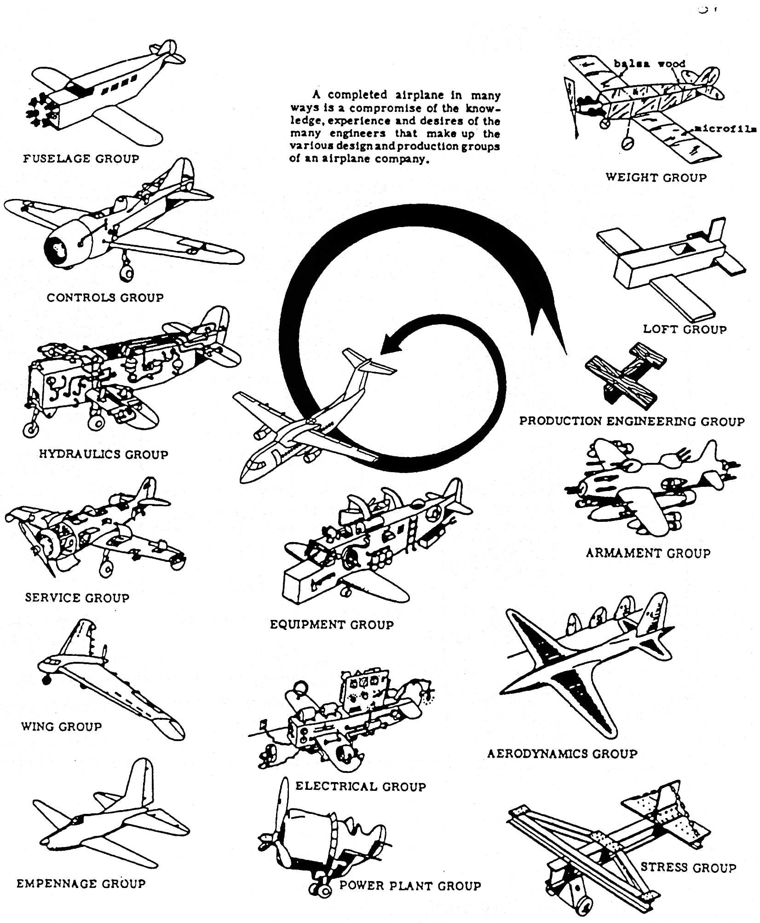
Lecture Contents
Preliminary Aircraft Sizing
6.1. Introduction
6.2. Payload-Range Diagram
6.3. Rapid Sizing Method for Aircraft Weight
6.3.1 Empty Weight Estimation
6.3.2 Fuel Weight Estimation
6.3.3 Example Calculations (business jet & prop)
6.4. T/W – W/S and W/P – W/S Diagrams
5.4.1 Sizing for Stall Speed
5.4.2 Sizing for Take-off Distance
5.4.3 Sizing for Landing Distance
5.4.4 Drag Polar & Climb Behavior Requirements
5.4.5 Maneuvering Behavior Requirements
5.4.6 Design Point & Sanity Checks
Notes:
Contents from this slide deck is sourced and adapted from Aircraft Design 1 Course content by Dr. Joris Melkert from Delft, University of Technology

Slide 4
Lecture Contents
Preliminary Aircraft Sizing
6.1. Introduction
6.2. Payload-Range Diagram
6.3. Rapid Sizing Method for Aircraft Weight
6.3.1 Empty Weight Estimation
6.3.2 Fuel Weight Estimation
6.3.3 Example Calculations (business jet & prop)
6.4. T/W – W/S and W/P – W/S Diagrams
5.4.1 Sizing for Stall Speed
5.4.2 Sizing for Take-off Distance
5.4.3 Sizing for Landing Distance
5.4.4 Drag Polar & Climb Behavior Requirements
5.4.5 Maneuvering Behavior Requirements
5.4.6 Design Point & Sanity Checks
Notes:
Contents from this slide deck is sourced and adapted from Aircraft Design 1 Course content by Dr. Joris Melkert from Delft, University of Technology

Slide 5
6.1 Introduction
- Payload - passengers, cargo, luggage & crew
- Range - with maximum payload (+ loiter)
- with other payload requirements
- Reserves - % or min of extra mission fuel
- Altitude - for design range
- Cruise speed - @ cruise altitude
@ given power setting
@ given weight
- Climb - time to given altitude at given weight
- Take-off - balanced field length at given field altitude
- Landing - landing length
- at given maximum landing weight
- Power plant - piston engine
- jet engine (turbojet/turboprop)
- Maneuvering requirements
- Certification basis
- W_{TO} Gross take-off weight
W_{E} Empty weight
W_{F} Mission fuel weight
T_{TO}, P_{TO} Max. required take-off thrust / power
S Wing surface area
A Wing slenderness/aspect ratio
C_{Lmax} Max. lift coefficient (clean configuration)
C_{LmaxTO} Max. lift coefficient (take-off)
C_{LmaxL} Max. lift coefficient (landing)
Preliminary sizing
Assignment 1 (Concept/config design, requirements…)
Assignment 2 (Prelim. Sizing)
Notes:
Sources:

Slide 6
Lecture Contents
Preliminary Aircraft Sizing
6.1. Introduction
6.2. Payload-Range Diagram
6.3. Rapid Sizing Method for Aircraft Weight
6.3.1 Empty Weight Estimation
6.3.2 Fuel Weight Estimation
6.3.3 Example Calculations (business jet & prop)
6.4. T/W – W/S and W/P – W/S Diagrams
5.4.1 Sizing for Stall Speed
5.4.2 Sizing for Take-off Distance
5.4.3 Sizing for Landing Distance
5.4.4 Drag Polar & Climb Behavior Requirements
5.4.5 Maneuvering Behavior Requirements
5.4.6 Design Point & Sanity Checks
Notes:
Contents from this slide deck is sourced and adapted from Aircraft Design 1 Course content by Dr. Joris Melkert from Delft, University of Technology

Slide 7
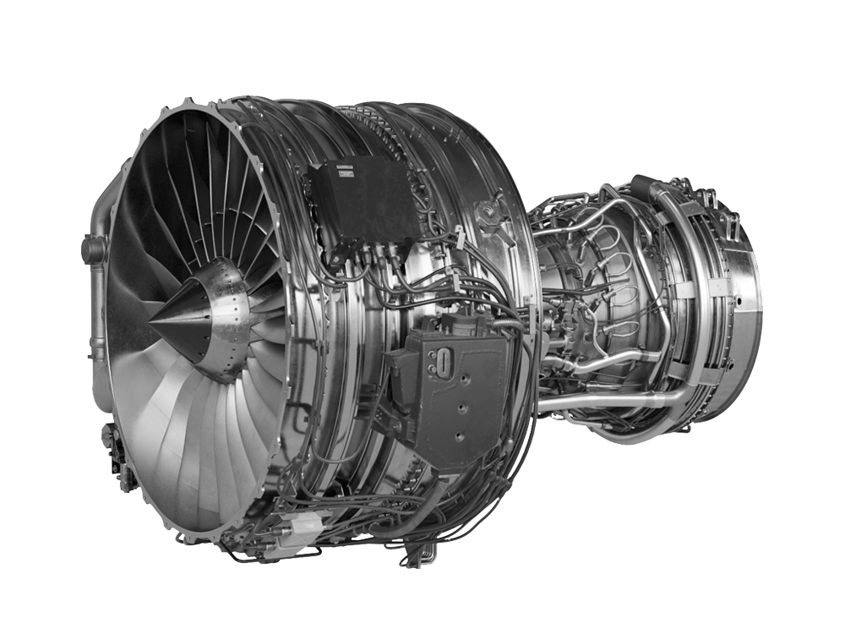

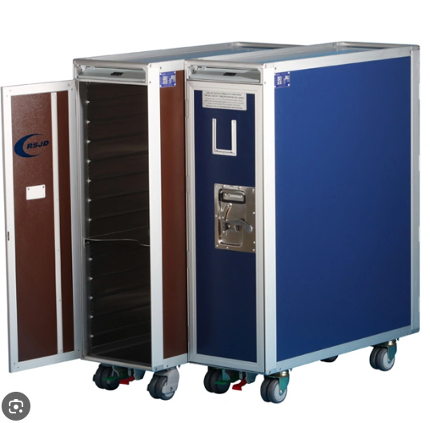
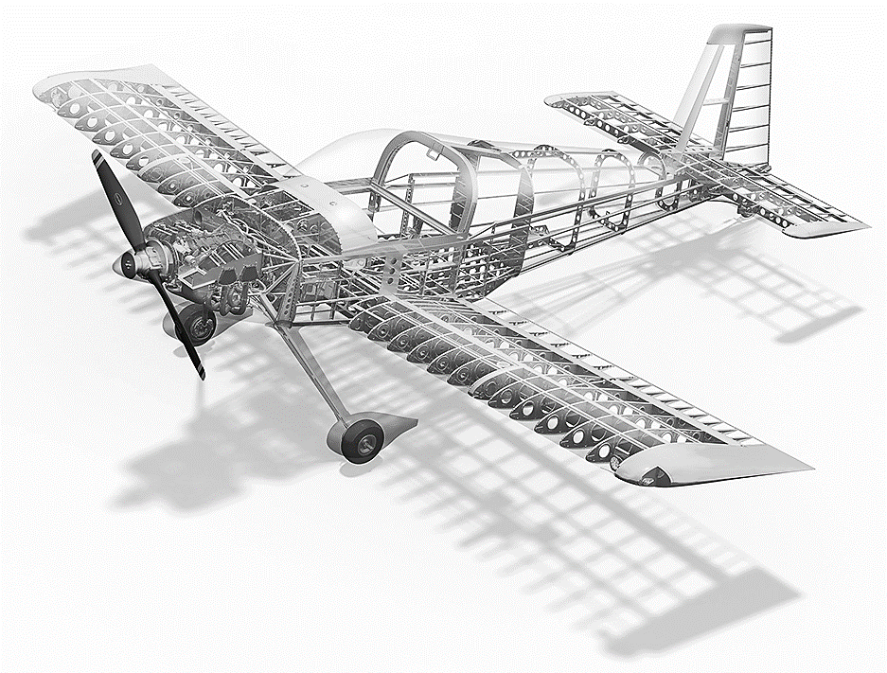
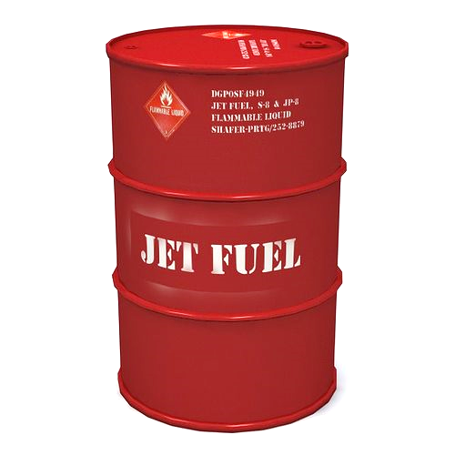
6.2 Payload – Range Diagram (Weight Definitions)
Before looking at the payload range diagram, it’s important to understand weight definitions
An aircraft’s weight consists of:
Airframe structure
Propulsion weight
Airframe services/systems & equipment weight
Fixed services & equipment
Removable services & equipment (standard items & variations)
Operational items
Payload
Fuel
Block fuel (trip fuel + pre-take-off fuel)
Reserve fuel (fuel at landing = reserve fuel + additional fuel)
Notes:
Sources:

Slide 8
6.2 Payload – Range Diagram (Weight Definitions)
Aircraft weight breakdown (not to scale):
Airframe services
and equipment
(Total) fuel
Res. fuel
Block fuel
Removable
Fuel at landing
Pre-take-off
fuel
Operational items
Propulsion
group
standard
item
variations
Payload
Airframe
structure
Standard
items
Reserve
fuel
Additional
fuel
Trip
fuel
Fixed
Notes:
Sources:

Slide 9
6.2 Payload – Range Diagram (Weight Definitions)
Airframe services
and equipment
(Total) fuel
Res. fuel
Block fuel
Removable
Fuel at landing
Pre-take-off
fuel
Operational items
Propulsion
group
standard
item
variations
Payload
Airframe
structure
Standard
items
Reserve
fuel
Additional
fuel
Trip
fuel
Fixed
Manufact. empty weight
(Delivery) empty weight
Basic (empty) weight
Disposable load
Operational empty weight
Useful load
Zero fuel weight
Fuel at take-off
Take-off weight
Ramp weight
Landing weight
Gross weight
Burn-off fuel
Notes:
Sources:

Slide 10
6.2 Payload – Range Diagram (Weight Definitions)
maximum take-off weight
Weight
TOW limited by MLW
take-off weight
maximum landing weight
maximum
additional fuel
trip
fuel
total fuel
maximum zero fuel weight
reserve
fuel
maximum useful load
maximum
structural
payload
useful fuel capacity
range
max. payload range
0
max. range
10
Notes:
Sources:

Slide 11

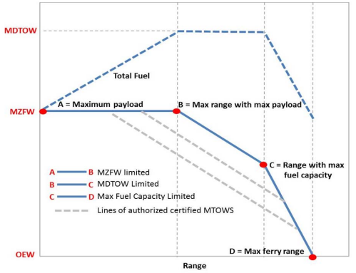
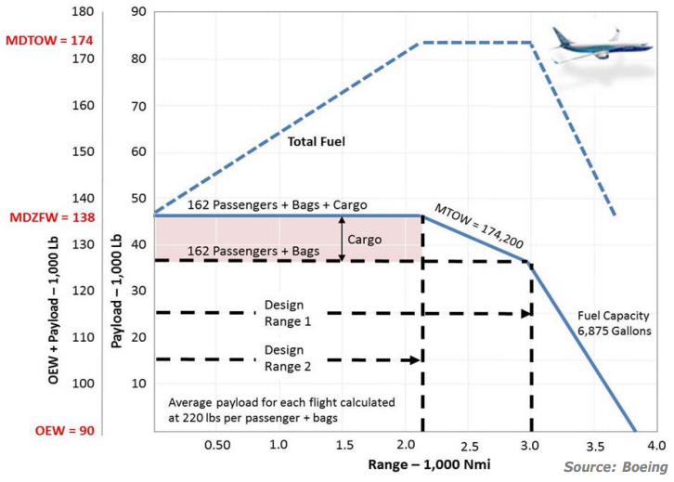
6.2 Payload – Range Diagram
Boeing 737-800 Payload Range Diagram
Notes:
Sources: https://catsr.vse.gmu.edu/SYST660/aircraft_payload_range_analysis_for_financiers___v1.pdf
The primary source for aircraft payload‐range diagrams is the Airplane Characteristics for Airport Planning document, which is published by each aircraft manufacturer. These documents provide, in an industry‐standardized format, airplane characteristics data for general airport planning. Sections within each document include: airplane description, airplane performance (including payload‐range performance), ground maneuvering, terminal servicing, operating conditions, and pavement data.

Slide 12
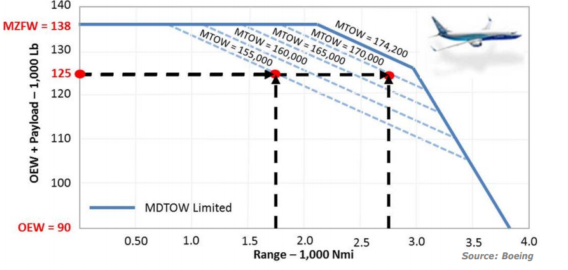
6.2 Payload – Range Diagram
Boeing 737-800 Payload Range Diagram
Notes:
Sources: https://catsr.vse.gmu.edu/SYST660/aircraft_payload_range_analysis_for_financiers___v1.pdf

Slide 13
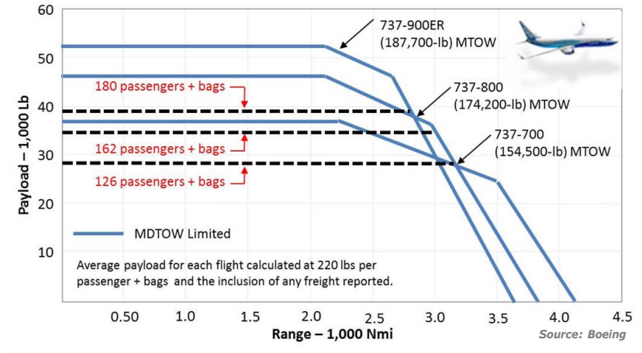
6.2 Payload – Range Diagram
Boeing 737 Family Payload Range Diagrams
Notes:
Sources: https://catsr.vse.gmu.edu/SYST660/aircraft_payload_range_analysis_for_financiers___v1.pdf

Slide 14
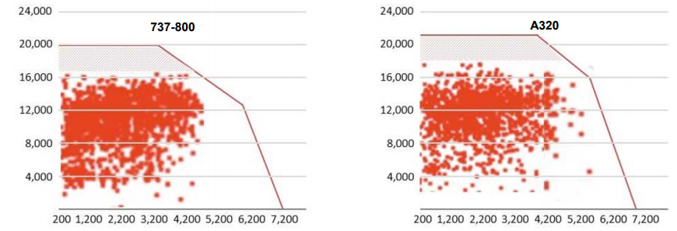
6.2 Payload – Range Diagram
Actual uses of aircraft is usually far below capabilities:
Notes:
Sources: https://catsr.vse.gmu.edu/SYST660/aircraft_payload_range_analysis_for_financiers___v1.pdf
Source: Trends in Aircraft Efficiency and Design Parameters - Zeinali, M, Ph.D. & Rutherford, D, Ph.D.

Slide 15
Lecture Contents
Preliminary Aircraft Sizing
6.1. Introduction
6.2. Payload-Range Diagram
6.3. Rapid Sizing Method for Aircraft Weight
6.3.1 Empty Weight Estimation
6.3.2 Fuel Weight Estimation
6.3.3 Example Calculations (business jet & prop)
6.4. T/W – W/S and W/P – W/S Diagrams
5.4.1 Sizing for Stall Speed
5.4.2 Sizing for Take-off Distance
5.4.3 Sizing for Landing Distance
5.4.4 Drag Polar & Climb Behavior Requirements
5.4.5 Maneuvering Behavior Requirements
5.4.6 Design Point & Sanity Checks
Notes:
Contents from this slide deck is sourced and adapted from Aircraft Design 1 Course content by Dr. Joris Melkert from Delft, University of Technology

Slide 16
6.3 Rapid Sizing Method for Aircraft Weight
W_{TO} = W_{OE} + W_{F} + W_{PL}
W_{OE} = W_{E} + W_{tfo} + W_{crew}
W_{tfo} = M_{tfo} * W_{TO}
M_{tfo} = 0.1% – 0.5%
Definitions:
W_{TO} (Gross) take-off weight
W_{OE} Operational empty weight
W_{F} Mission fuel weight
W_{PL(tot)} (Total) payload weight
W_{E} Empty weight
W_{tfo} Weight of trapped fuel and oil
W_{crew} Crew weight (pilots + flight attendants)
W_{TO} = W_{E} + W_{F} + W_{PL} + W_{crew} + M_{tfo} * W_{TO}
For small aircraft: W_{PLtot} = W_{PL} + W_{crew}
W_{TO} = W_{E} + W_{F} + W_{PLtot} + M_{tfo} * W_{TO}
Notes:
Note the percentage sign! (0.001 – 0.005)
Remember Weight = N, mass = kg!

Slide 17
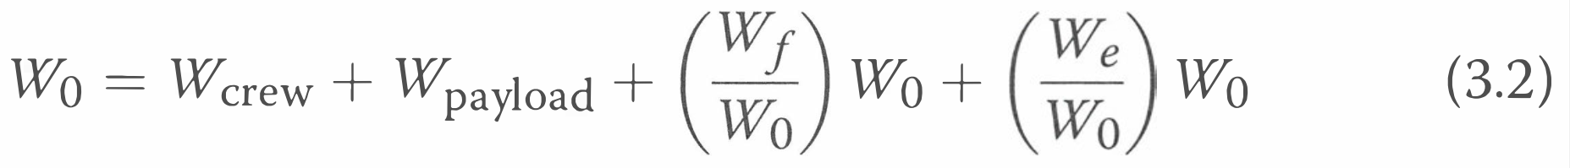
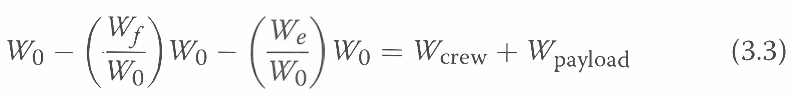
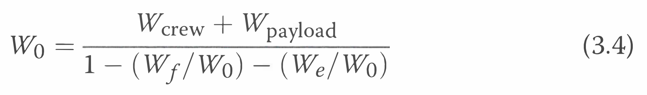
6.3 Rapid Sizing Method for Aircraft Weight

Slide 18
6.3 Rapid Sizing Method for Aircraft Weight
W_{E} is unknown, but a statistical relation can be found between W_{E} and W_{TO}
W_{F} can be estimated from the mission profile and engine data (see later)
W_{PLtot} can be estimated from the assignment & fuselage configuration info
W_{TO} = W_{E} + W_{F} + W_{PLtot} + M_{tfo} * W_{TO}
Collect at least 20 reference aircraft in the same category as your aircraft
Collect data on weights (W_{TO} ,W_{E} , W_{PL} )
Also collect data on Take-off Thrust, range, climb rates, speeds (cruise, maximum cruise, stall), take-off and landing lengths, etc. you will need them later!
If your aircraft type does not have many comparable examples available, consider that the aircraft doesn’t feel whether the payload is alive or not! For now, only mass counts!

Slide 19
6.3.1 Empty Weight Estimation
Example reference data:

Slide 20
6.3.1 Empty Weight Estimation

Slide 21
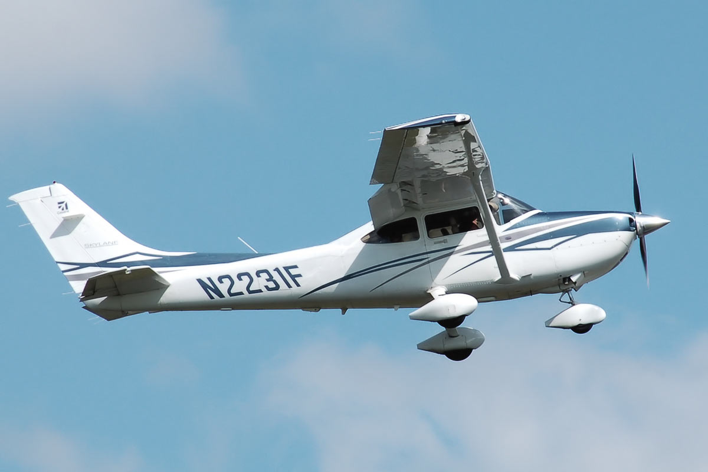
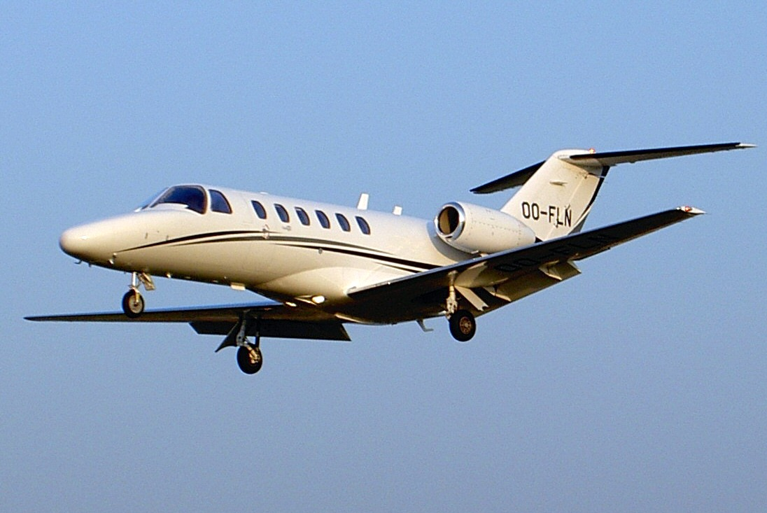
6.3.1 Empty Weight Estimation
Notes:
Can display this information using normal or logarithmic plots.

Slide 22
6.3.1 Empty Weight Estimation
Regression methods:
Linear: W_{E} = a * W_{TO} + b
Logarithmic: log (W_{E}) = (log (W_{TO}) – A)/B
Single engine prop. aircraft: a = 0.5482 b = 486.68
A = -0.1440 B = 1.1162
Business jet aircraft: a = 0.5417 b = 579.96
A = 0.2678 B = 0.9979

Slide 23
6.3.1 Empty Weight Estimation
Notes:
SE = Single Engine
BJ = Business Jet
Logarithmic regression may produce better results locally, but could diverge significantly away from datapoints!

Slide 24
6.3.1 Empty Weight Estimation
Notes:
SE = Single Engine
BJ = Business Jet
Logarithmic regression may produce better results locally, but could diverge significantly away from datapoints!

Slide 25
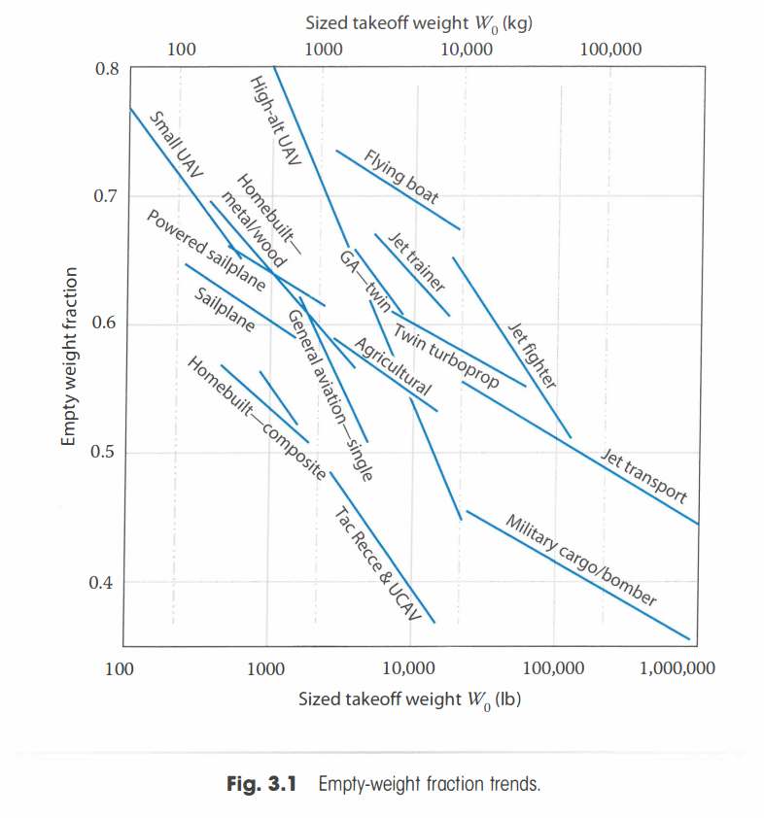
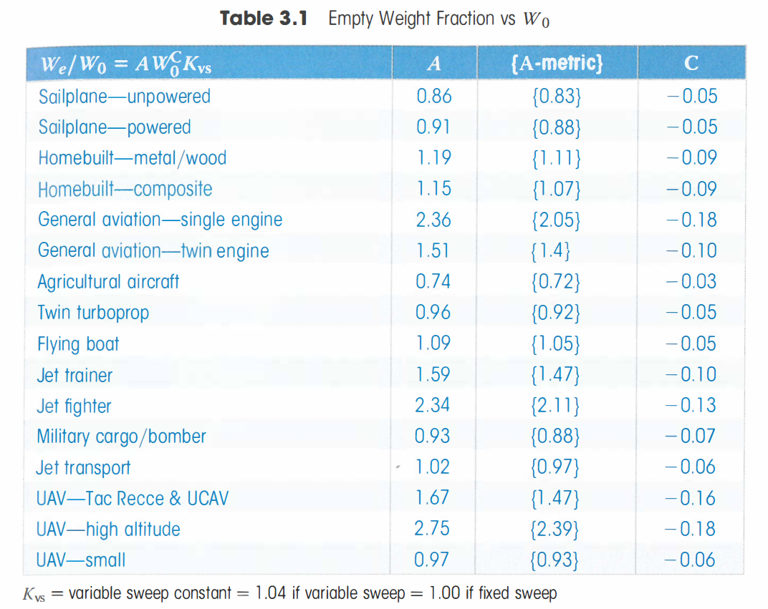
6.3.1 Empty Weight Estimation
Notes:
Source: Raymer

Slide 26
6.3.2 Fuel Weight Estimation
Definitions:
W_{F} Mission fuel weight
W_{Fres} Reserve fuel weight
W_{Fused} Used fuel weight
M_{used} Used mass fraction
W_{TO} Take-off weight
M_{res} Reserved mass fraction
M_{ff} Mass fractions from used fuel (mission profile)
Reserve fuel determined by:
Fraction of fuel used (M_{res} = 0% to 100%), OR
Mission profile extension (fly to alternate and/or loiter for given amount of time), in this case M_{res} = 0
W_{F} = W_{Fres} + W_{Fused}
W_{Fused} = M_{used} * W_{TO}
M_{used} = (1 – M’_{ff})
W_{Fres} = M_{res} * W_{Fused}
W₁
i = n
W_{i+1}
Π
M’_{ff} =
W_{TO}
i = 1
W_{i}
weight fraction after first step
weight fractions after in subseq. steps
Notes:
All weight fractions may be determined by use of statistical values except those for fuel intensive flight phases such as cruise, loiter and flying to an alternate.
When available, the use of real data is preferred!

Slide 27
6.3.2 Fuel Weight Estimation (Mission Profiles)
A mission profile shows the steps in a typical flight for the aircraft:
Mission Profile example:
Engine start and warm-up
Taxi
Take-off
Climb
Cruise
Descent
Landing, taxi and shut-down
Mission Profile example 2:
Engine start and warm-up
Taxi
Take-off
Climb 1
Cruise 1
Descent 1
Climb 2
Cruise 2
Loiter
Descent 2
Landing, taxi and shut-down
Reserve fraction (fly to alternate)
Reserve fraction or fly to alternate + loiter
5
8
9
4
6
1
2
3
7
10
11

Slide 28
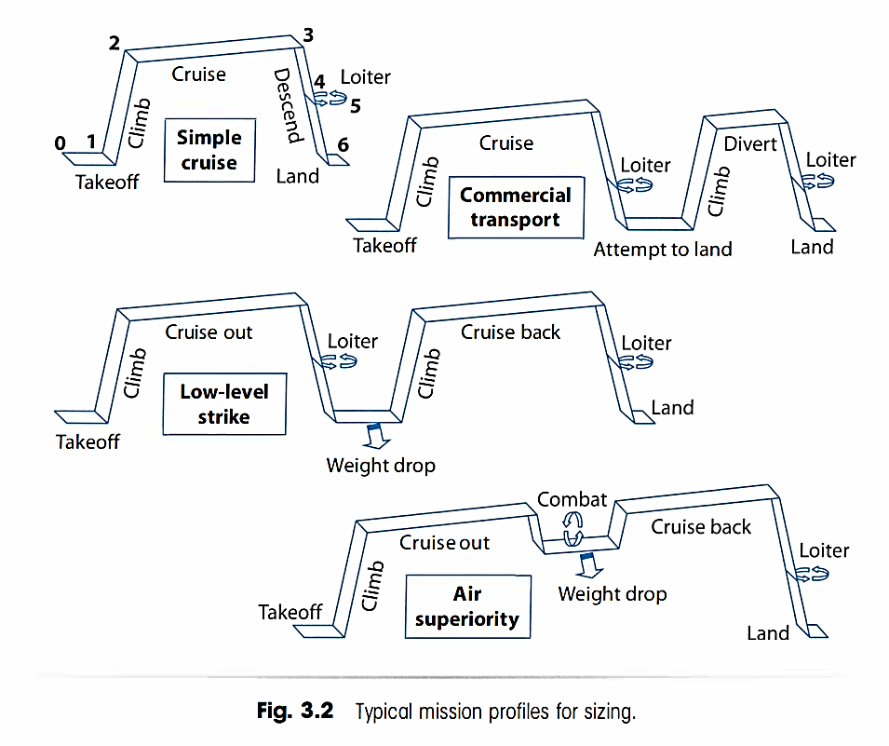
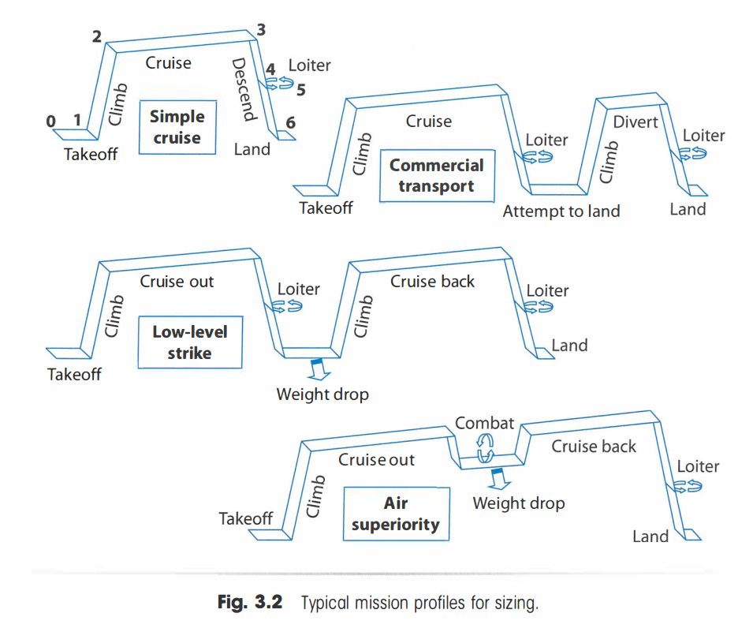
6.3.2 Fuel Weight Estimation (Mission Profiles)
Notes:
Raymer

Slide 29
6.3.2 Fuel Weight Estimation
W₁
i = n
W_{i+1}
Π
M’_{ff} =
W_{TO}
W_{i}
Weight fractions for typical non-fuel intensive phases:
i = 1
Aircraft type | Engine start & warm-up | Taxi | Take-off | Climb | Descent | Landing, taxi and shut-down
Homebuilt aircraft | 0.998 | 0.998 | 0.998 | 0.995 | 0.995 | 0.995
Single engine piston props | 0.995 | 0.997 | 0.998 | 0.992 | 0.993 | 0.993
Twin engine props | 0.992 | 0.996 | 0.996 | 0.990 | 0.992 | 0.992
Agricultural | 0.996 | 0.995 | 0.996 | 0.998 | 0.999 | 0.998
Business jets | 0.990 | 0.995 | 0.995 | 0.980 | 0.990 | 0.992
Regional turboprops | 0.990 | 0.995 | 0.995 | 0.985 | 0.985 | 0.995
Transport jets | 0.990 | 0.990 | 0.995 | 0.980 | 0.990 | 0.992
Military trainers | 0.990 | 0.990 | 0.990 | 0.980 | 0.990 | 0.995
Fighters | 0.990 | 0.990 | 0.990 | 0.96 - 0.9 | 0.990 | 0.995
Military patrol, bombers and transport | 0.990 | 0.990 | 0.995 | 0.980 | 0.990 | 0.992
Flying boats, amphibians and float planes | 0.992 | 0.990 | 0.996 | 0.985 | 0.990 | 0.990
Supersonic aircraft | 0.990 | 0.995 | 0.995 | 0.92 - 0.87 | 0.985 | 0.992

Slide 30
6.3.2 Fuel Weight Estimation
W₁
i = n
W_{i+1}
Π
M’_{ff} =
W_{TO}
W_{i}
Weight fractions for typical fuel intensive phases:
Use Breguet’s range equations (for cruise) and endurance equations (for loiter)
Different equations for propeller driven vs. jet driven aircraft:
For propeller-driven aircraft:
For jet-driven aircraft:
i = 1
Notes:
R = Range in m
E = Endurance in seconds

Slide 31
6.3.2 Fuel Weight Estimation
W₁
i = n
W_{i+1}
Π
M’_{ff} =
W_{TO}
W_{i}
Weight fractions for typical fuel intensive phases:
Since R,E is known from requirements & market, solve for W_{i}/W_{i+1}
For propeller-driven aircraft:
For jet-driven aircraft:
i = 1
R = range in m
E = endurance in sec
V = speed in m/s
L = lift in N
D = drag in N
W = weight in N
η_{p} = propulsive efficiency (no unit)
c_{p} = specific fuel consumption of a propeller engine in kg/J or μg/J (US: lbs/hr/hp)
c_{j} = specific fuel consumption of a jet engine in kg/Ns or mg/Ns (US: lbs/hr/lbs)
g = acceleration due to gravity (9.80665 m/s²)
Note: the SI-unit for mass is kg not g!
Notes:
R = Range in m
E = Endurance in seconds

Slide 32
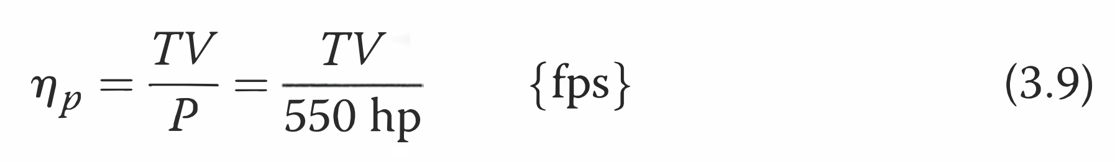
6.3.2 Fuel Weight Estimation
Propulsive efficiency can be calculated from installed power, thrust and speed:

Slide 33
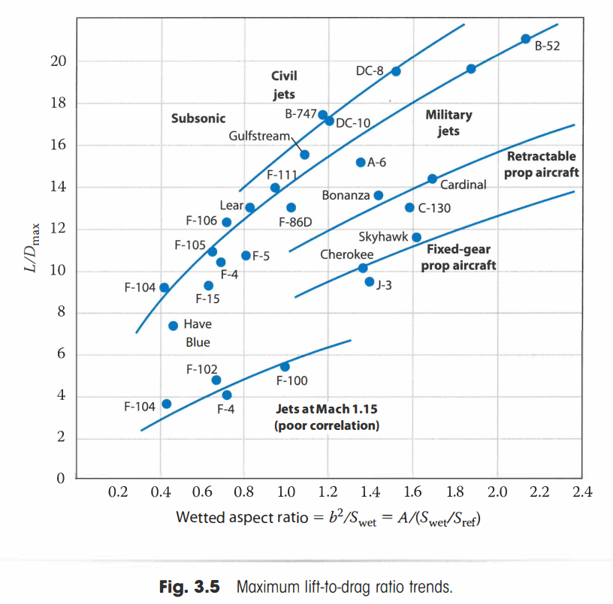
6.3.2 Fuel Weight Estimation

Slide 34
6.3.2 Fuel Weight Estimation
Typical cruise data for range calculations:
Aircraft type | L/D [-] | c_{j} [lbm/hr/lbf] | c_{p} [lbm/hr/hp] | η_{p} [-]
Homebuilt aircraft | 8-10 | - | 0.6 - 0.8 | 0.7
Single engine piston props | 8-10 | - | 0.5 - 0.7 | 0.8
Twin engine props | 8-10 | - | 0.5 - 0.7 | 0.82
Agricultural | 5-7 | - | 0.5 - 0.7 | 0.82
Business jets | 10-12 | 0.5 - 0.9 | - | -
Regional turboprops | 11-13 | - | 0.4 - 0.6 | 0.85
Transport jets | 13-15 | 0.5 - 0.9 | - | -
Military trainers | 8-10 | 0.5 - 0.9 | 0.4 - 0.6 | 0.82
Fighters | 4-7 | 0.6 - 1.4 | 0.5 - 0.7 | 0.82
Military patrol, bombers and transport | 13-15 | 0.5 - 0.9 | 0.4 - 0.7 | 0.82
Flying boats, amphibians and float planes | 10-12 | 0.5 - 0.9 | 0.5 - 0.7 | 0.82
Supersonic aircraft | 4-6 | 0.7 - 1.5 | - | -
Notes:
Lbs = pounds mass
Lbf = pounds force

Slide 35
6.3.2 Fuel Weight Estimation
Typical loiter data for endurance calculations:
Aircraft type | L/D [-] | c_{j} [lbs/hr/lbs] | c_{p} [lbs/hr/hp] | η_{p} [-]
Homebuilt aircraft | 10-12 | - | 0.5 - 0.7 | 0.6
Single engine piston props | 10-12 | - | 0.5 - 0.7 | 0.7
Twin engine props | 9-11 | - | 0.5 - 0.7 | 0.72
Agricultural | 8-10 | - | 0.5 - 0.7 | 0.72
Business jets | 12-14 | 0.4 - 0.6 | - | -
Regional turboprops | 14-16 | - | 0.5 - 0.7 | 0.77
Transport jets | 14-18 | 0.4 - 0.6 | - | -
Military trainers | 10-14 | 0.4 - 0.6 | 0.5 - 0.7 | 0.77
Fighters | 6-9 | 0.6 - 0.8 | 0.5 - 0.7 | 0.77
Military patrol, bombers and transport | 14-18 | 0.4 - 0.6 | 0.5 - 0.7 | 0.77
Flying boats, amphibians and float planes | 13-15 | 0.4 - 0.6 | 0.5 - 0.7 | 0.77
Supersonic aircraft | 7-9 | 0.6 - 0.8 | - | -

Slide 36
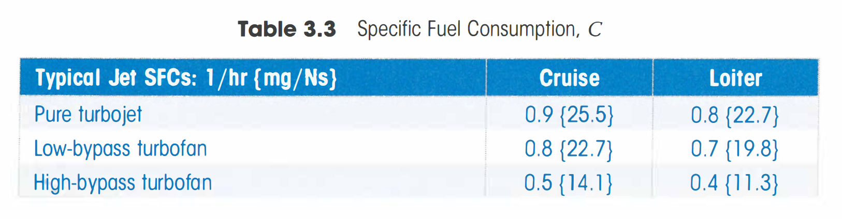
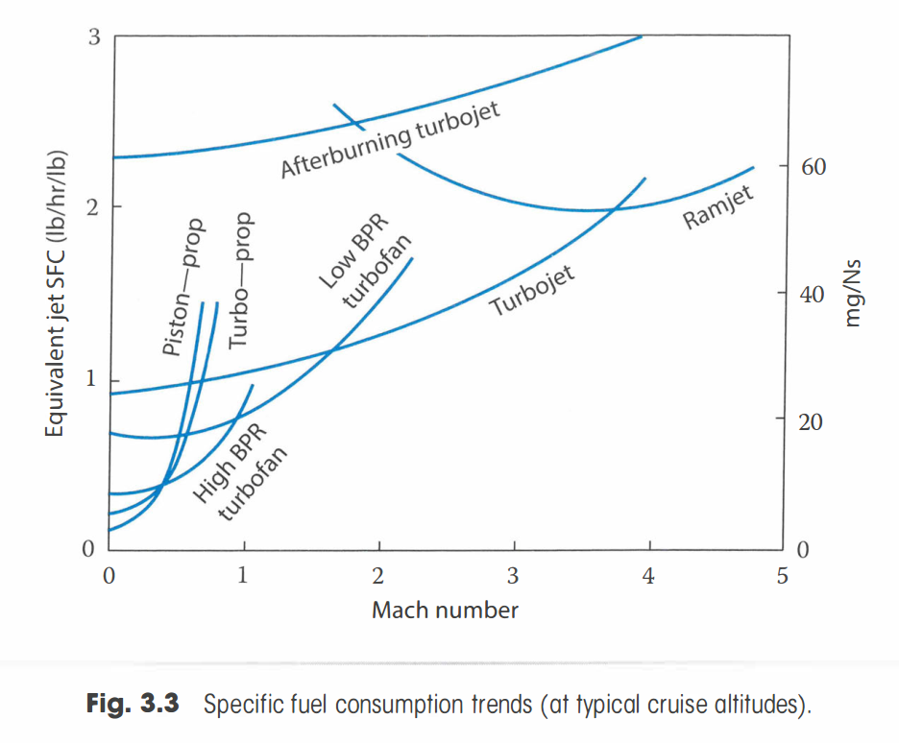
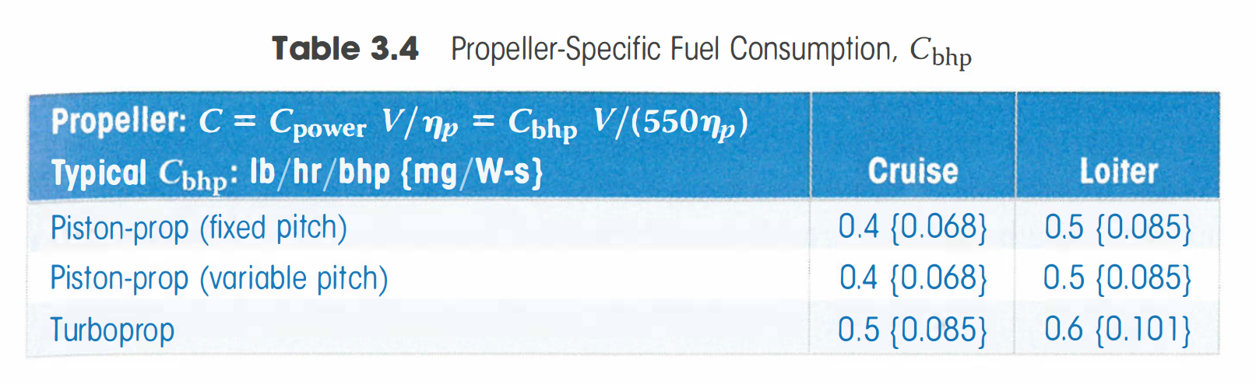
6.3.2 Fuel Weight Estimation
Typical fuel consumption:

Slide 37
6.3.2 Fuel Weight Estimation
Useful SFC Conversions:
Internal:
Imperial to SI:
SI to imperial:

Slide 38
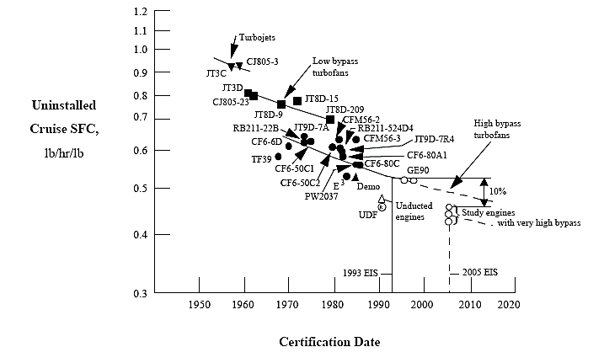
6.3.2 Fuel Weight Estimation
Typical aircraft engines and consumption get better over time:

Slide 39
6.3.2 Fuel Weight Estimation
Example range calculation:
R for a propeller aircraft:
R for a jet aircraft:
V = 250 m/s
L/D = 15
W₄/W₅ = 1.176
η_{p} = 0.82
c_{p} = 90 μg/J (propeller aircraft)
c_{j} = 19 mg/Ns (jet aircraft)

Slide 40
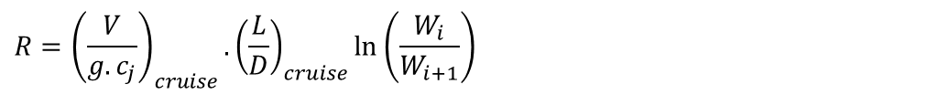
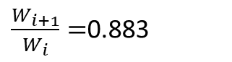
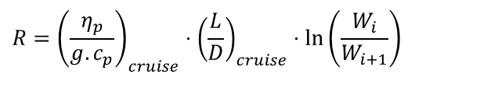
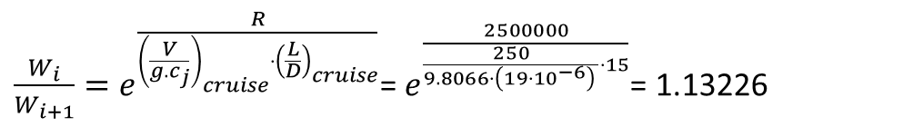
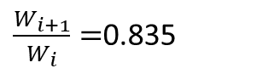
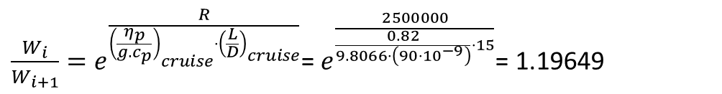
6.3.2 Fuel Weight Estimation
Example range calculation:
R for a propeller aircraft:
R for a jet aircraft:
V = 250 m/s
L/D = 15
Range = 2500km
η_{p} = 0.82
c_{p} = 90 μg/J (propeller aircraft)
c_{j} = 19 mg/Ns (jet aircraft)
$$R={\left(\frac{η_{p}}{g.c_{p}}\right)}_{cruise}⋅{\left(\frac{L}{D}\right)}_{cruise}⋅\ln\left(\frac{W_{i}}{W_{i+1}}\right)$$
$\frac{W_{i}}{W_{i+1}}=e^{\frac{R}{{\left(\frac{η_{p}}{g.c_{p}}\right)}_{cruise}{⋅\left(\frac{L}{D}\right)}_{cruise}}}$= $e^{\frac{2500000}{\frac{0.82}{9.8066⋅\left(90⋅10^{−9}\right)}⋅15}}$= 1.19649
$\frac{W_{i+1}}{W_{i}}=$0.835
$$R={\left(\frac{V}{g.c_{j}}\right)}_{cruise}.{\left(\frac{L}{D}\right)}_{cruise}\ln\left(\frac{W_{i}}{W_{i+1}}\right)$$
$\frac{W_{i}}{W_{i+1}}=e^{\frac{R}{{\left(\frac{V}{g.c_{j}}\right)}_{cruise}{⋅\left(\frac{L}{D}\right)}_{cruise}}}$= $e^{\frac{2500000}{\frac{250}{9.8066⋅\left(19⋅10^{−6}\right) }⋅15}}$= 1.13226
$\frac{W_{i+1}}{W_{i}}=$0.883

Slide 41
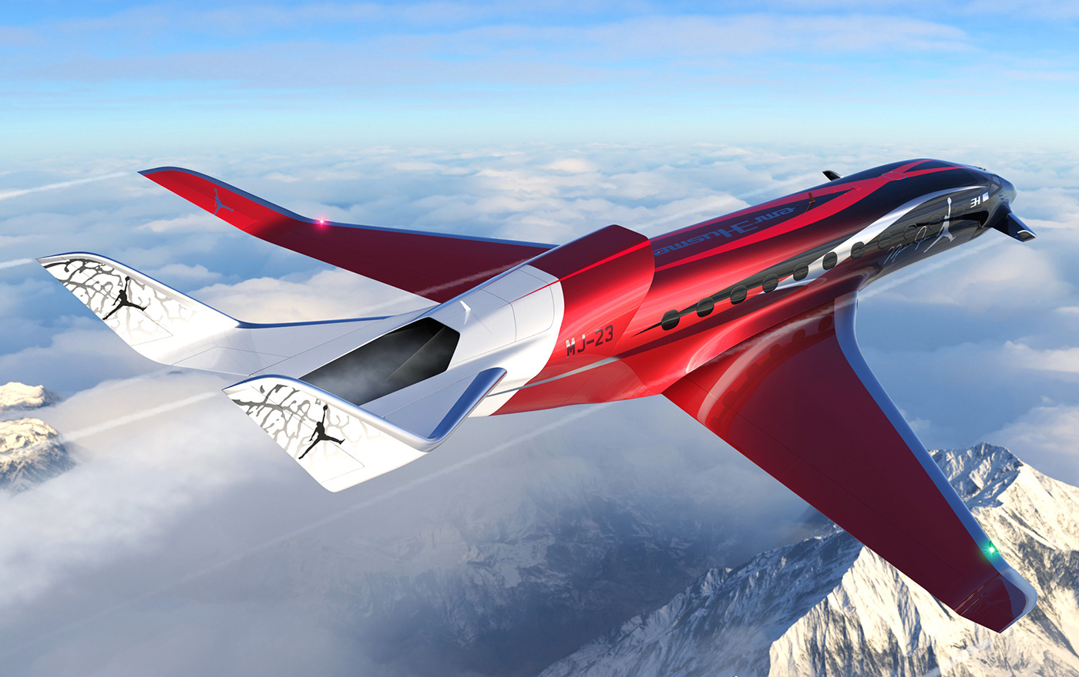
6.3.3 Example Calculations (Business Jet)
Example mass fraction calculation for a business jet:
W_{PL} = 2250 kg
R₁ = 4200 km
R₂ = 500 km.
E_{loiter} = 45 min.
V_{cr} = 850 km/hr.
W_{crew} = 350 kg.
c_{j} = 0.7 lb./hr./lb.
Notes:
https://www.behance.net/gallery/105455299/2030-EH-001-Business-Jet

Slide 42
6.3.3 Example Calculations (Business Jet)
Example mission for a business jet Weight fraction
Engine start and warm-up 0.990
Taxi 0.995
Take-off 0.995
Climb 1 0.980
Cruise 1 0.757
Descent 1 0.990
Climb 2 0.990
Cruise 2 0.943
Loiter 0.974
Descent 2 0.995
Landing, taxi and shut-down 0.992
M’_{ff} = 0.6457

Slide 43
6.3.3 Example Calculations (Business Jet)
Example mission for a business jet: Take-off weight estimation
W_{TO} = W_{E} + W_{F} + W_{PLtot} + W_{tfo}
W_{TO} = 0.5417 * W_{TO} + 579.96 + (1-M’ff) * W_{TO} + (2250+350)*9.80665 + 0.001 * W_{TO}
Solving for W_{TO} :
W_{TO} = 0.897 * W_{TO} + 26,077 N
0.103 * W_{TO} = 26,077 N
Results in:
W_{TO} = 253,177 N
(M_{TO}= 25,817 kg or 56,890 lbs.)

Slide 44
6.3.3 Example Calculations (Business Jet)
Example mission for a business jet: Fuel and Empty weight estimations
From the take-off weight, we can calculate the fuel and empty weight:
W_{TO} = 253,177 N
W_{E} = 0.5417 * W_{TO}
= 137,726 N
W_{F} = (1-M’ff) * W_{TO}
= 89,700 N
W_{Fused} = (1-0.99*0.995*0.995*0.98*0.7566*0.99*0.992)*W_{TO}
= (1-0.7137) * W_{TO}
= 72,485 N
W_{Fres} = W_{F} - W_{Fused} = 17,215 N
M_{res} = W_{Fres}/W_{Fused} = 0.237

Slide 45
6.3.3 Example Calculations (Business Jet)
Example mission for a business jet: Sanity Check
Notes:
Does it match your trend data? If so; good! If not: why not?

Slide 46
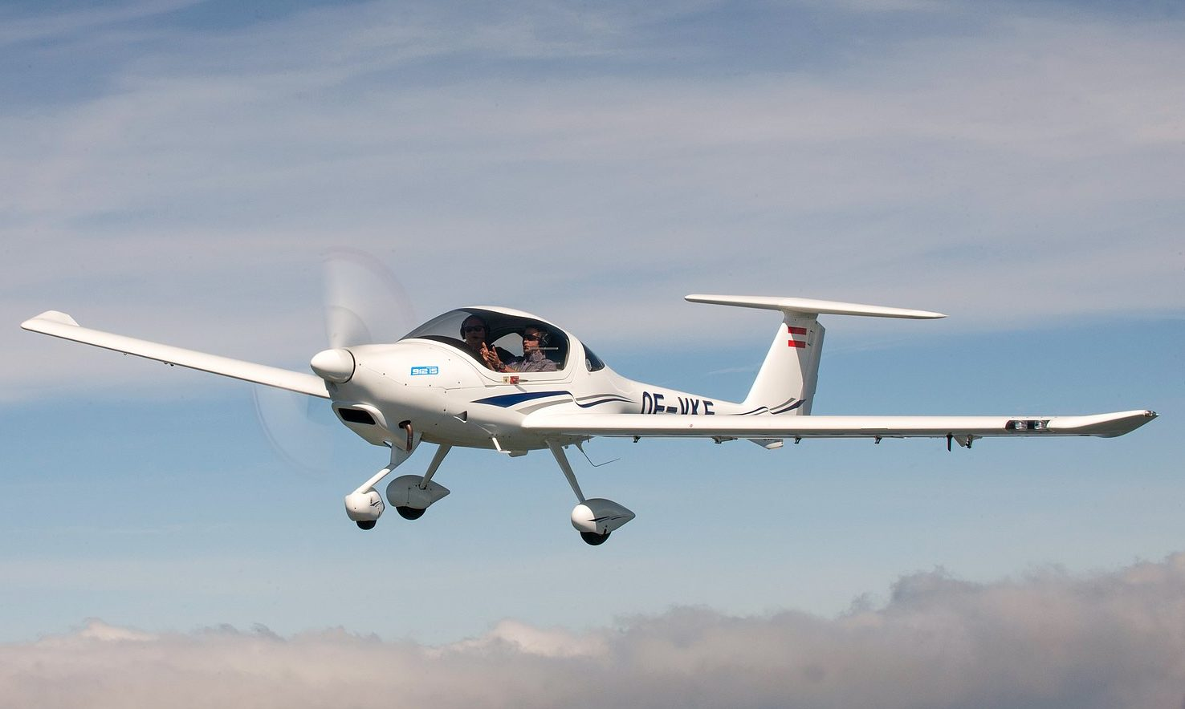
6.3.3 Example Calculations (Single Engine Propeller)
Example calculation for a single engine propeller aircraft:
M_{PLtot} = 200 kg
R = 1000 km
M_{res} = 20%
η_{p} = 80%
c_{p} = 0.50 lb./hp./hr.
Notes:
Diamond DA20 Katana
https://wildnordics.com/wp-content/uploads/2020/06/csm_DA20i_Highlight_1_Design_Bild_2_d1c2f53092-e1600009924222.jpg

Slide 47
6.3.3 Example Calculations (Single Engine Propeller)
Example calculation for a SE aircraft: Weight fraction
Engine start and warm-up 0.995
Taxi 0.997
Take-off 0.998
Climb 0.992
Cruise 0.897
Descent 0.993
Landing, taxi and shut-down 0.993
M’_{ff} = 0.867

Slide 48
6.3.3 Example Calculations (Single Engine Propeller)
Example mission for a business jet: Take-off weight estimation
W_{TO} = W_{E} + W_{F} + W_{PLtot} + W_{tfo}
W_{TO} = 0.5482 * W_{TO} + 486.68 + W_{Fres} + W_{Fused} + 200 * 9.80665 + 0.005 * W_{TO}
W_{TO} = 0.5482 * W_{TO} + 486.68 + (1+0.2) * (1-M’ff) * W_{TO} + 1961 + 0.005 * W_{TO}
Solving for W_{TO} :
W_{TO} = 0.5532 * W_{TO} + 2447.7 + (1 + 0.20) * 0.131 * W_{TO}
0.2896 * W_{TO} = 2,447.7 N
Results in:
W_{TO} = 8,452 N
= 861.9 kg
= 1,899 lbs.

Slide 49
6.3.3 Example Calculations (Single Engine Propeller)
Example mission for a business jet: Fuel and Empty weight estimations
From the take-off weight, we can calculate the fuel and empty weight:
W_{TO} = 8,452 N
W_{E} = 4,680 N
W_{F} = 1,329 N
W_{Fused} = 1,107 N

Slide 50
6.3.3 Example Calculations (Single Engine Propeller)
Example mission for a business jet: Sanity Check
Notes:
Does it match your trend data? If so; good! If not: why not?

Slide 51
Lecture Contents
Preliminary Aircraft Sizing
6.1. Introduction
6.2. Payload-Range Diagram
6.3. Rapid Sizing Method for Aircraft Weight
6.3.1 Empty Weight Estimation
6.3.2 Fuel Weight Estimation
6.3.3 Example Calculations (business jet & prop)
6.4. T/W – W/S and W/P – W/S Diagrams
5.4.1 Sizing for Stall Speed
5.4.2 Sizing for Take-off Distance
5.4.3 Sizing for Landing Distance
5.4.4 Drag Polar & Climb Behavior Requirements
5.4.5 Maneuvering Behavior Requirements
5.4.6 Design Point & Sanity Checks
Notes:
Contents from this slide deck is sourced and adapted from Aircraft Design 1 Course content by Dr. Joris Melkert from Delft, University of Technology

Slide 52
How to stay on track?
Complete your CAD models (generating/annotating technical drawings)?
Complete your generated concepts
Complete the fuselage design for your selected concept
Complete assignment 1 (Due soon)!
Get started on your “class 1 weight estimation”

Slide 53
PRELIMINARY SIZING 1
AESP 415 – Aircraft Design Part I Basics
Lecture 7
MODULE
2
TOPIC 6
Thank You!
Dr. Wout De Backer
1000 Catawba St, Ste 120
wdbacker@cec.sc.edu

